Slide 1

RADV Risk Adjustment Data Validation Tool
FHIRed UP
Augusto Burgos aburgos3@gatech.edu Spiro Ganas spiroganas@gmail.com Anja Guillory anjag1993@gmail.com Jamie Richgels jrichgels3@gatech.edu Daniel Stoneburner dstoneburner3@gatech.edu Tala Suidan tmsuidan@gatech.edu

Slide 2
Updated Gantt Chart
* All team members involved † - Developers and testers involved ‡ - Business Analysts involved
Milestones and tasks in purple and dark blue are complete. Remainder are in progress or in the future
Notes:
Items to discuss:
This slide presents an updated Gantt chart
Scope is set until we ensure we make the most of its current reach.
The 3 2-week sprints are complete thanks to Augusto, Spiro, and Anja. The 4th is underway with a final 1 week spring to correct any remaining bugs.
Analysis is complete
Code testing is occurring on a continual basis by Dan and other team members.
Documentation has started and will be completed a week after the 4th sprint.

Slide 3
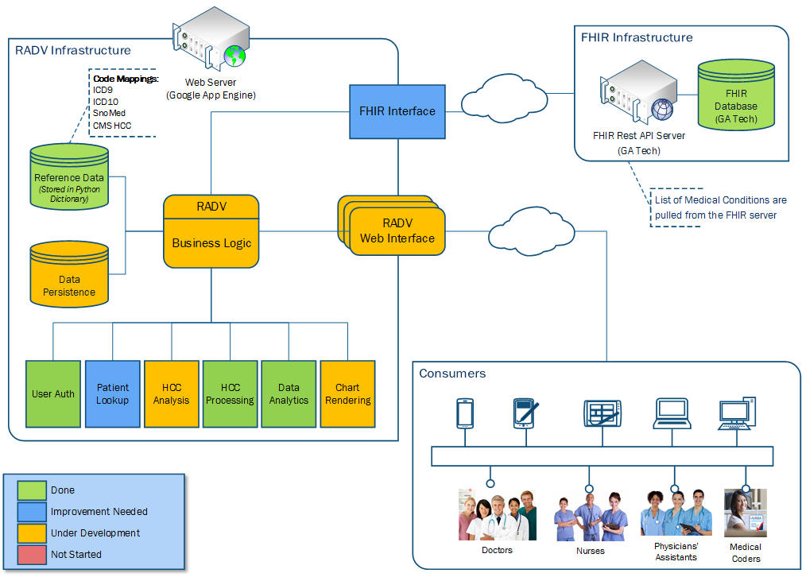
Updated RADV Architecture
Notes:
This updated architecture diagram reflects changes since the last deliverable, The RADV web interface is now in beta testing, we have also completed the HCC processing module and the data analytics module. Chart Rendering continues to be under development. We have also decided to add data persistence layer that will allow providers to store HCCs and Notes.

Slide 4
RADV Application Walk-Through

Slide 5
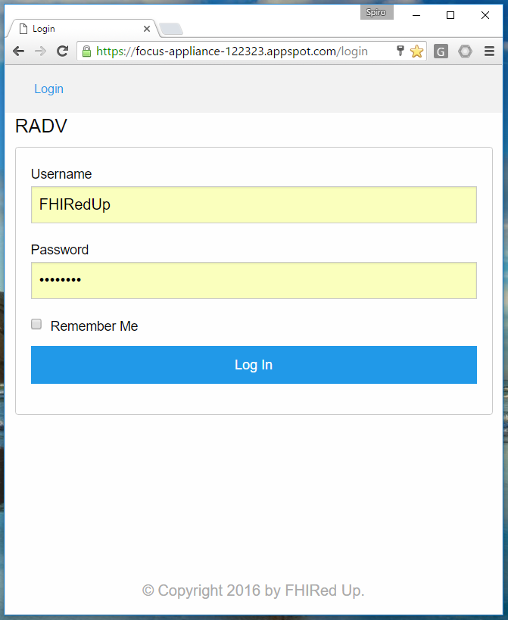
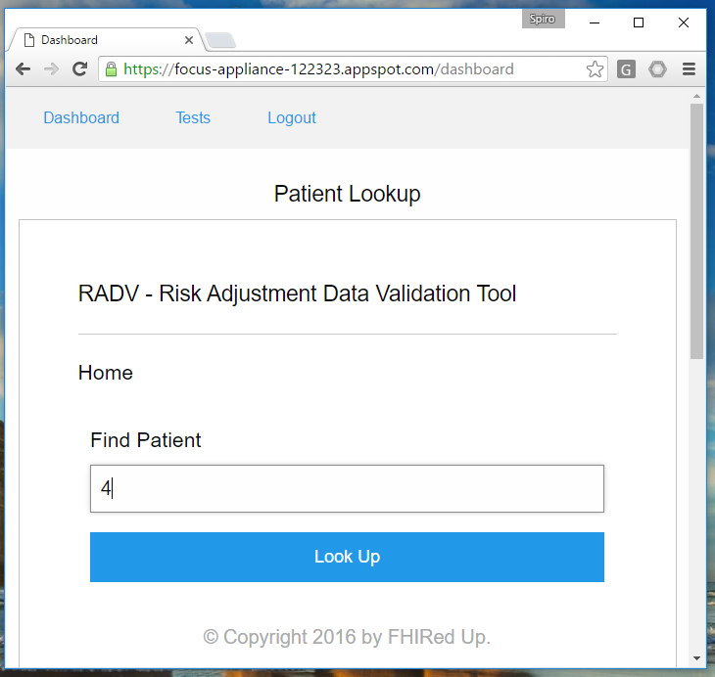
Notes:
Identity and Authentication interface
Patient search interface – search element being the patient’s identification number for the user (provider)

Slide 6
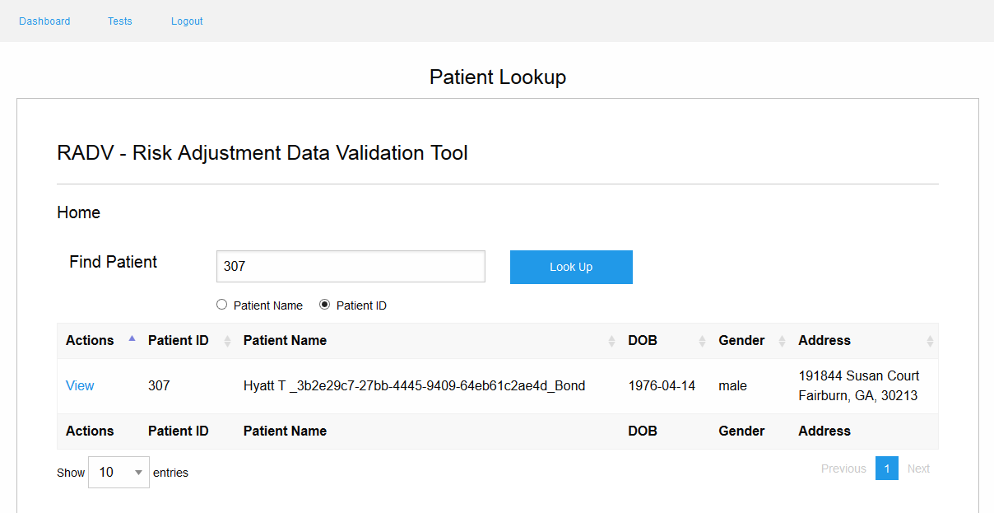

Slide 7
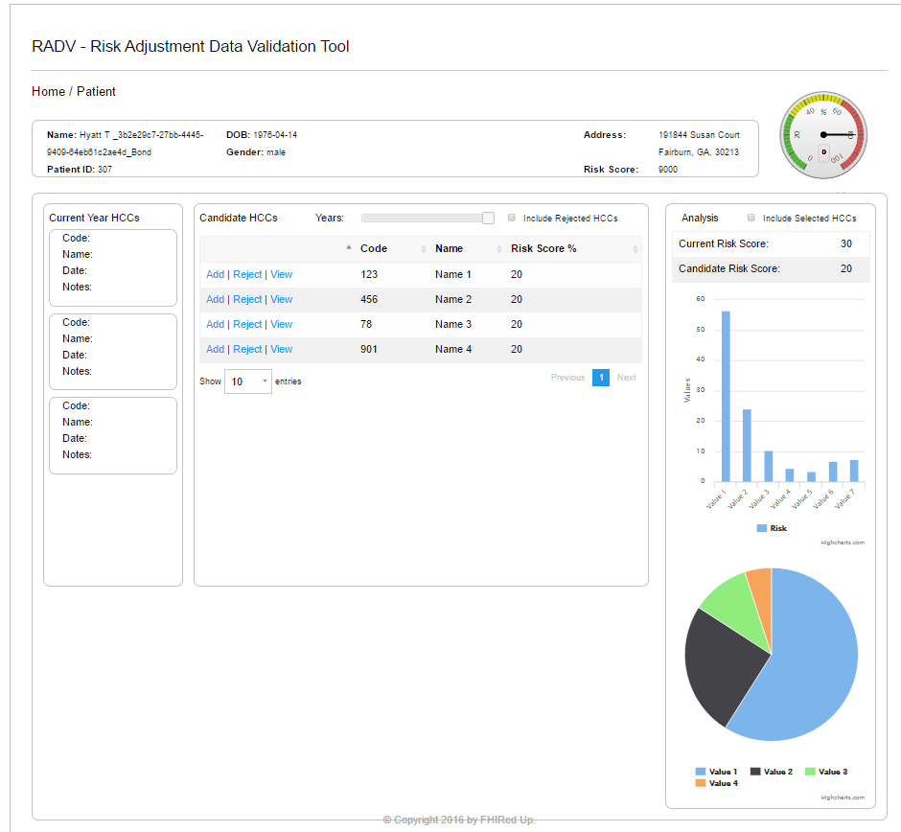
Notes:
Dashboard –
Gets a list of candidate HCCs that are updated into a list a missing patient diagnoses for that provider, with the choice of adding, rejecting, or viewing each HCC.

Slide 8
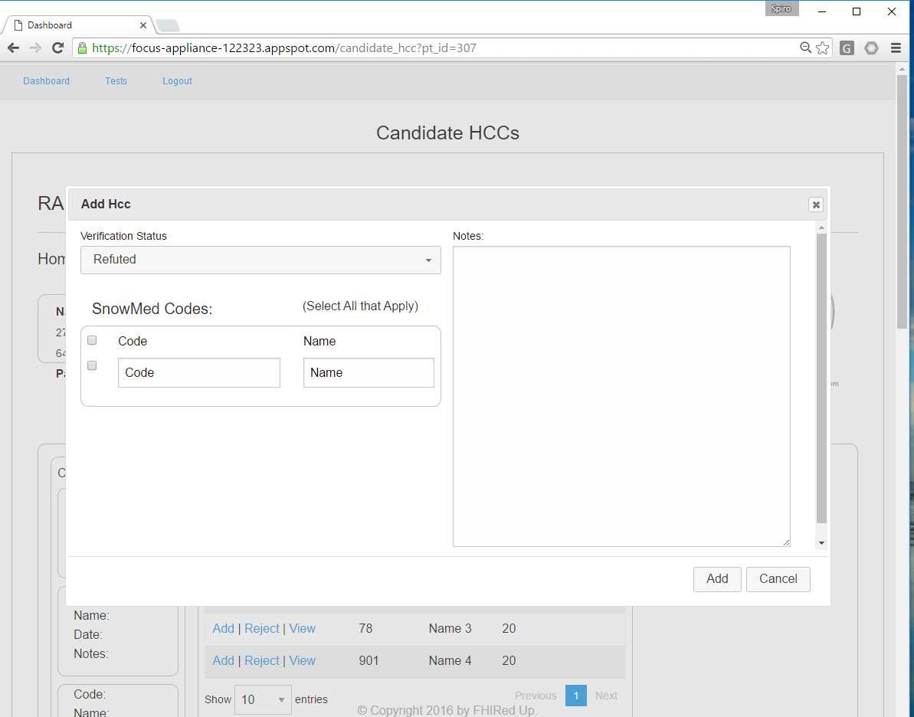
Notes:
Add Candidate HCC interface –
Extracts a list of candidate diagnoses to verify for making the decision to add a candidate diagnosis for a given patient who’s chosen diagnosis is missing in the provider’s list for the patient

Slide 9
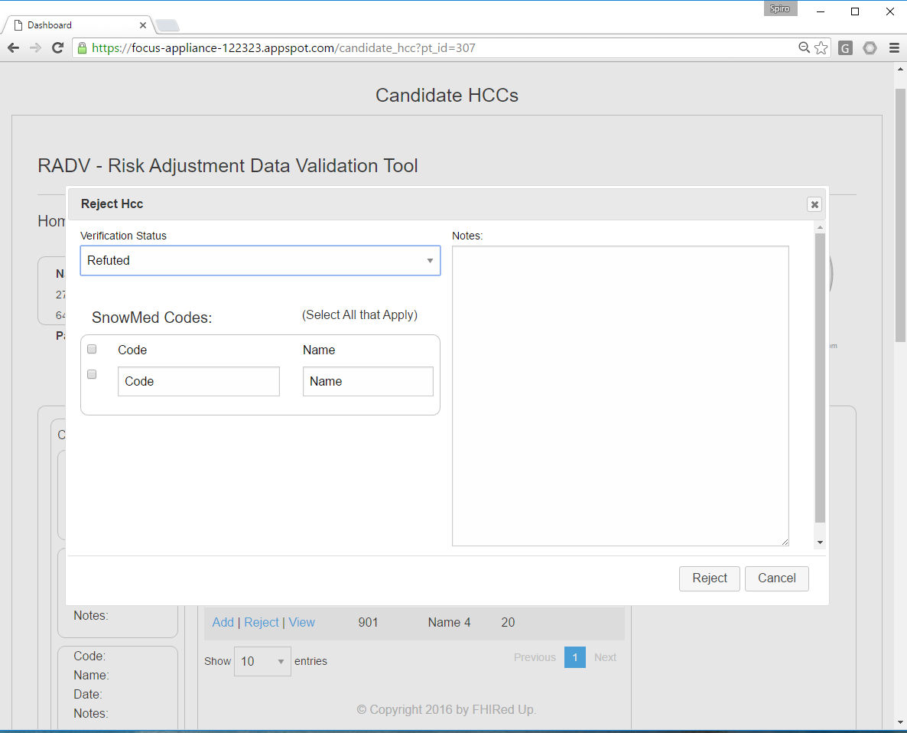
Notes:
Reject Candidate HCC interface –
Extracts a list of current candidate diagnoses to verify for making the decision to reject a listed candidate diagnosis for a given patient who’s chosen diagnosis is no longer active.

Slide 10
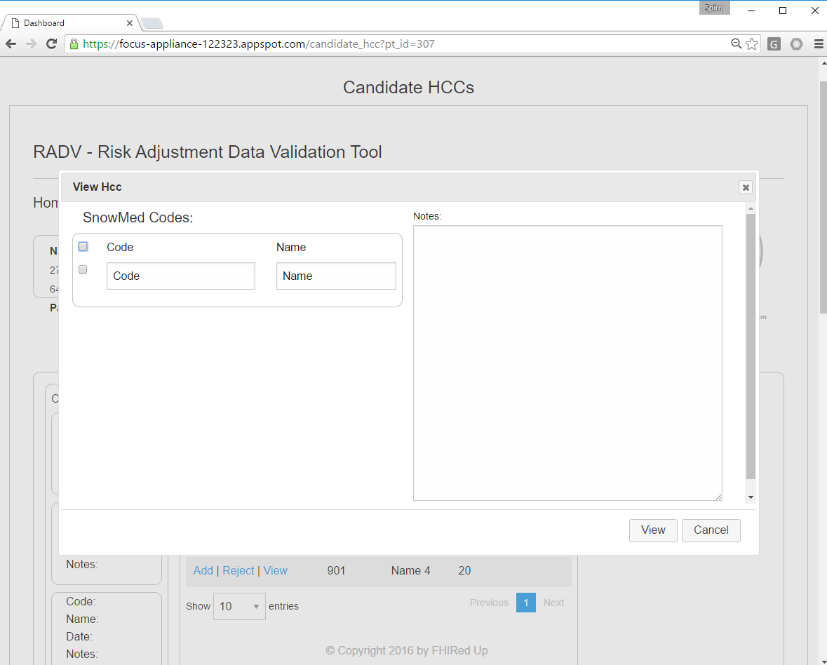
Notes:
View Candidate HCC interface –
Allows the provider to view a specific element of the current list of candidate diagnoses for this patient.

Slide 11
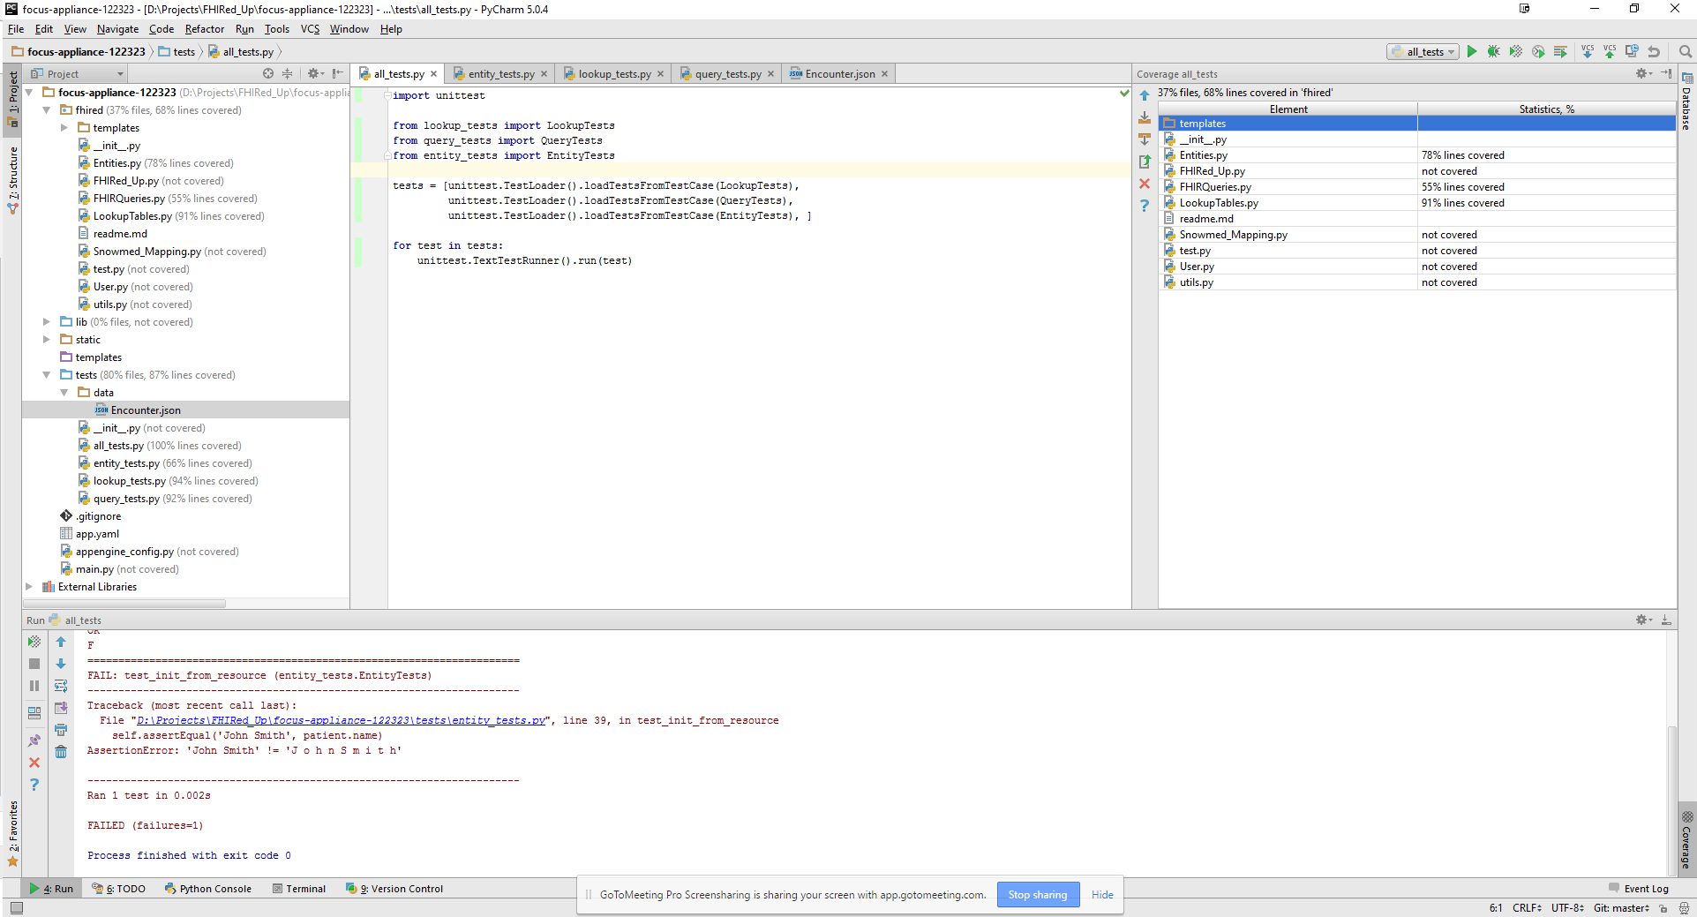
QA Testing
Notes:
Python’s unittest module was used to automate testing. Test suites have been developed for all of RADVs main modules. The test cases currently cover 68% of lines of code. We anticipate code coverage of approximately 85% in the final version of the tool.

Slide 12
Concerns & Other Issues
Application speed
Persistent data
Connecting the frontend web application to the backend database tier
Notes:
The RADV application makes many calls to the FHIR server. We are exploring ways to use caching to reduce this network traffic. We are also implementing a Google DataStore, which will allow us to store lookup tables and other persistent data. Finally, we are in the process of connecting the charts in the web application to live data from the database system.

Slide 13
Beta Version of the RADV Tool
https://focus-appliance-122323.appspot.com/login
Login: FHIRedUp
Password: PjV7kGTD
Notes:
This final slide shows the web address of the RADV tool. You can use this username and password to view the beta version of the software.

